Slide 1

Mapping Solutions
The HYIP Project

Slide 2
Introduction
This Presentation is the 2nd Range of Our Mapping System.
On The 1st Range called Mapping Ideas which stand as the Basic Concept of our Mapping we have explained on how we bring the way on capturing ideas in to a conceptual diagram.
Starting from how the ideas are categorized to define the best way to share the one that works, we have came to our conclusion that the easiest method to replicate the ideas is when we formulated them in to 2 (two) pairs, 3 (three) steps, 4 (four) bases and 5 (five) frames.
As continuation, here we present the same way on how we use the formation and formulate them on getting a best concept to bring the solution. Similar to what we have shown on the 1st Mapping here we also adopt the uniformity of nature and their interactions across environments

Slide 3


Basic Concept
Basic Concept is Available on our
Mapping Ideas

Slide 4
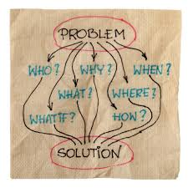
Definition
It is a Tools to help you achieve the maximum benefit from your ideas.

Slide 5


Why Mapping Solutions
Main Objective of Our Mapping Solutions is to share What Works

Slide 6


Solutions Package
It is a Tools to help you achieve the maximum benefit from your ideas.

Slide 7


Mapping the Solutions
Mapping Solutions can greatly enhance projects, reports, and presentations that are critical for problem solving, decision making, and management.

Slide 8

Routes for Solutions
Routes on Mapping is geared towards a concept to navigate the solutions.

Slide 9


Four (4) bases
Let’ start on four (4) bases category.

Slide 10

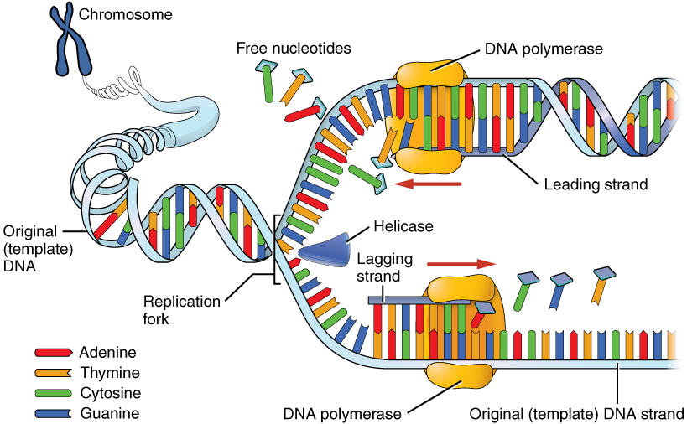

Replication
Four (4) bases category on Chromosome and DNA.

Slide 11
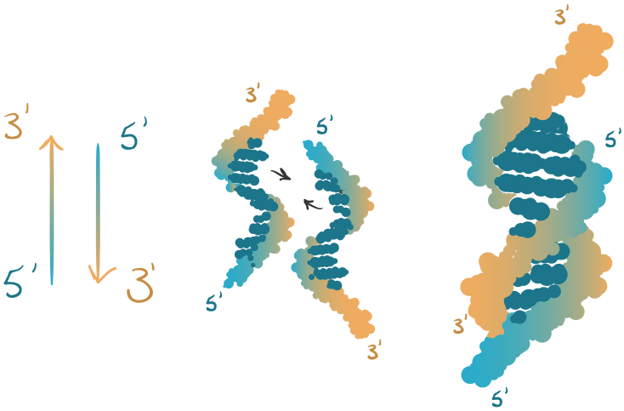

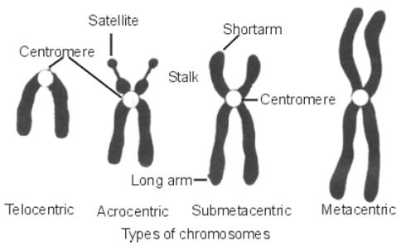
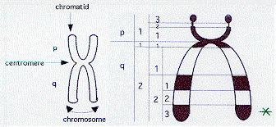
Steps and Frames
Four (4) bases category in Between.

Slide 12
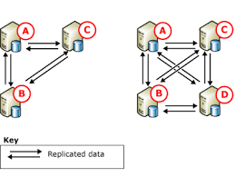
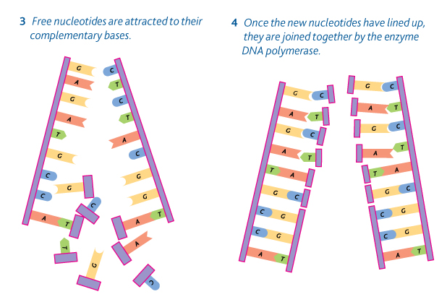
Phenomena
Our Mapping Solutions adopt every nature phenomena that are uniform and conceptually structured on our case of problem solving and decision making.

Slide 13
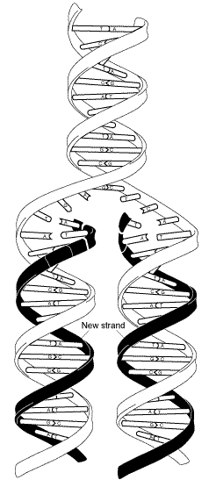
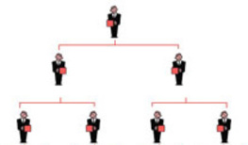

Three to Four
Four (4) bases category are Mapped by Three to Four.

Slide 14
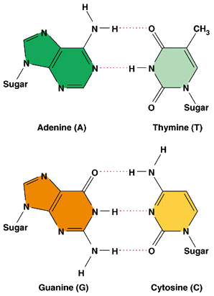
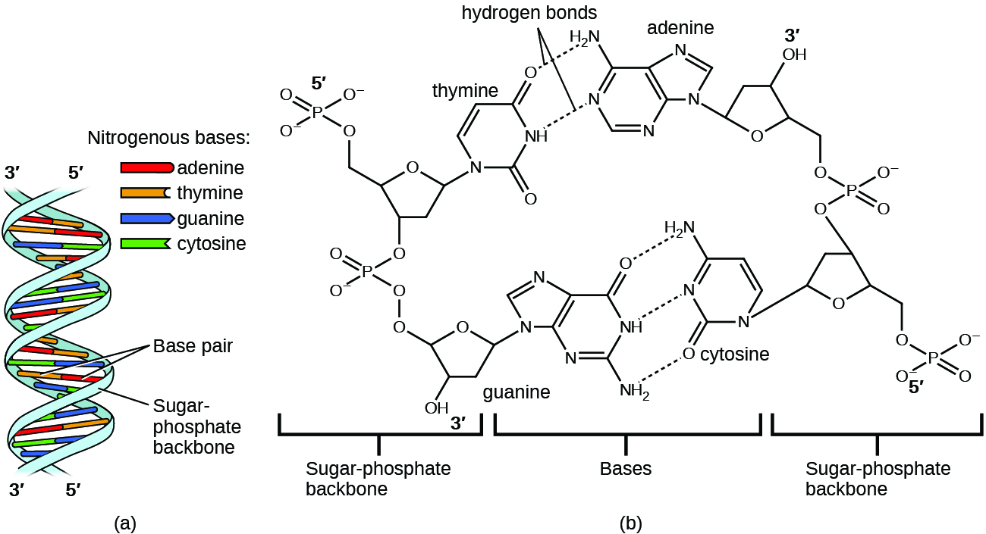
Two (2) Pairs
The Four (4) bases category by two (2) in pairs.

Slide 15
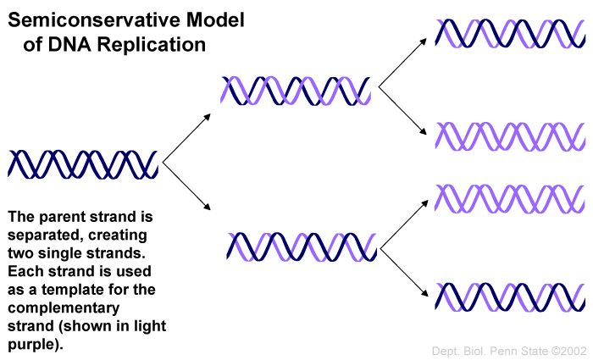



Pairing

Slide 16






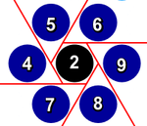
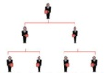
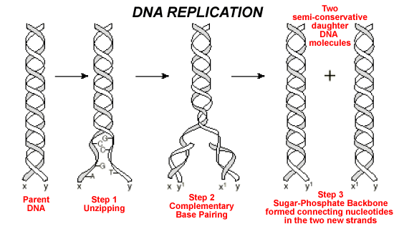
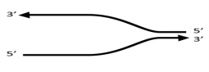
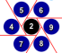
The nine (9) modules
2 pairs
3 steps
4 bases
5 frames
9 modules

Slide 17
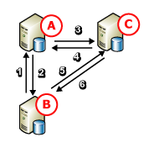


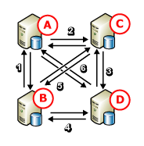
Pairs from The Seven
Three (3) by Four (4) are pairs from The Seven (7).

Slide 18
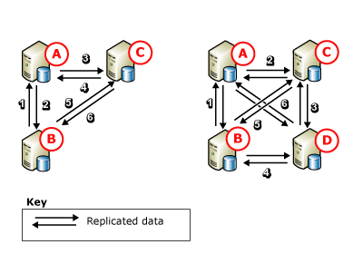

Routes in Pairs
Three (3) by Four (4) has routes by six (6) in pairs.

Slide 19
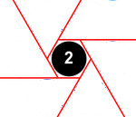

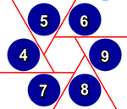
The Six (6) Routes
Three (3) by Four (4) has routes by six (6) routes in hexagonal.

Slide 20
The three (3)
The three (3) from seven (7) has six (6) routes in hexagonal.

Slide 21
The Four (4)
The three (4) from seven (7) has six (6) routes in pairs.

Slide 22
Solutions Maps
The 3 to 4 are pairs from 7
The 3 has 6 routes
The 4 has 6 routes in pair
The 6 routes are hexagonal
The inner is by 2nd pair
The outer is from 4 to 9
The merging is back to 7

Slide 23
Our Mapping Range
Mapping Ideas
Mapping Solutions
Mapping Out
Mapping Grouping
Mapping Relations
Mapping Activities
Mapping Maps

Slide 24
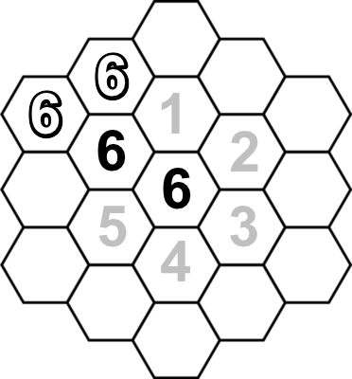
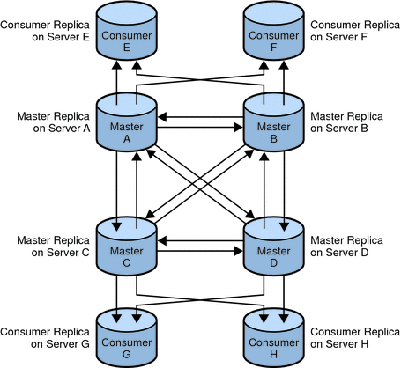
Our Next Mapping
Mapping Out
Mapping Group
See you on our next mapping….

